Slide 1
REGISTER TRANSFER LANGUAGE
In symbolic notation, it is used to describe the micro-operations transfer among registers. It is a kind of intermediate representation (IR) that is very close to assembly language, such as that which is used in a compiler. The term “Register Transfer” can perform micro-operations and transfer the result of operation to the same or other register.
Micro-operations : The operation executed on the data store in registers are called micro-operations. They are detailed low-level instructions used in some designs to implement complex machine instructions.
Register Transfer : The information transformed from one register to another register is represented in symbolic form by replacement operator is called Register Transfer.
Replacement Operator : In the statement, R2 <- R1, <- acts as a replacement operator. This statement defines the transfer of content of register R1 into register R2.

Slide 2
There are various methods of RTL –
General way of representing a register is by the name of the register enclosed in a rectangular box as shown in (a).
Register is numbered in a sequence of 0 to (n-1) as shown in (b).
The numbering of bits in a register can be marked on the top of the box as shown in (c).
A 16-bit register PC is divided into 2 parts- Bits (0 to 7) are assigned with lower byte of 16-bit address and bits (8 to 15) are assigned with higher bytes of 16-bit address as shown in (d).

Slide 3
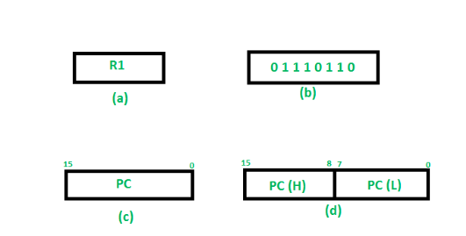

Slide 4
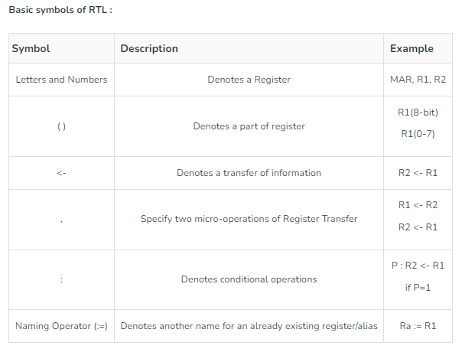

Slide 5
Register Transfer Operations:
The operation performed on the data stored in the registers are referred to as register transfer operations.
There are different types of register transfer operations:
1. Simple Transfer – R2 <- R1
The content of R1 are copied into R2 without affecting the content of R1. It is an unconditional type of transfer operation.

Slide 6
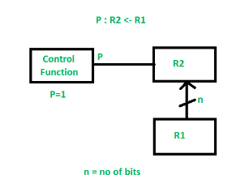
2. Conditional Transfer –
It indicates that if P=1, then the content of R1 is transferred to R2. It is a unidirectional operation.

Slide 7
3. Simultaneous Operations – If 2 or more operations are to occur simultaneously then they are separated with comma (,).
If the control function P=1, then load the content of R1 into R2 and at the same clock load the content of R2 into R1.

Slide 8
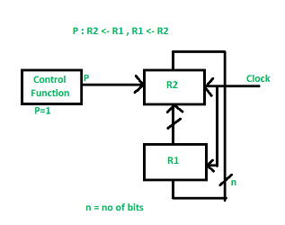

Slide 9



Arithmetic micro-operation
Addition – In addition micro-operation, the value in register R1 is added to the value in the register R2 and then the sum is transferred into register R3.
There is another way of doing the subtraction. In this, 2’s complement of R2 is added to R1, which is equivalent to R1 – R2, and then the result is transferred into register R3

Slide 10




Arithmetic micro-operation
Increment – In Increment micro-operation, the value inside the R1 register is increased by 1.
Decrement – In Decrement micro-operation, the value inside the R1 register is decreased by 1.
1’s Complement – In this micro-operation, the complement of the value inside the register R1 is taken.
2’s Complement – In this micro-operation, the complement of the value inside the register R2 is taken and then 1 is added to the value and then the final result is transferred into the register R2. This process is also called Negation. It is equivalent to -R2.

Slide 11
Arithmetic micro-operation
Arithmetic micro-operations are the basic building blocks of arithmetic operations performed by a computer’s central processing unit (CPU). These micro-operations are executed on the data stored in registers, which are small, high-speed storage units within the CPU.
There are several types of arithmetic micro-operations that can be performed on register data, including:
Addition: This micro-operation adds two values together and stores the result in a register.
Subtraction: This micro-operation subtracts one value from another and stores the result in a register.
Increment: This micro-operation adds 1 to the value in a register.
Decrement: This micro-operation subtracts 1 from the value in a register.
Multiplication: This micro-operation multiplies two values together and stores the result in a register.
Division: This micro-operation divides one value by another and stores the quotient and remainder in separate registers.
Shift: This micro-operation shifts the bits in a register to the left or right, depending on the direction specified.

Slide 12
Logic micro-operations
Logic micro-operations
Logic microoperations specify binary operations for strings of bits stored in registers.
These operations consider each bit of the register separately and treat them as binary variables.
For example, the exclusive-OR microoperation with the contents of two registers R1 and R2 is symbolized by the statement
P: R1ꚛR2
It specifies a logic microoperation to be executed on the individual bits of the registers provided that the control variable P = 1.
1 0 1 0 contents of R1
1 1 0 0 contents of R2
0 1 1 0 contents of R1 after P=1
The contents of R1 after execution of the micro-operation, is equal to bit-by-bit exclusive OR operation on each pair of bits in R2 and previous values of R1.

Slide 13
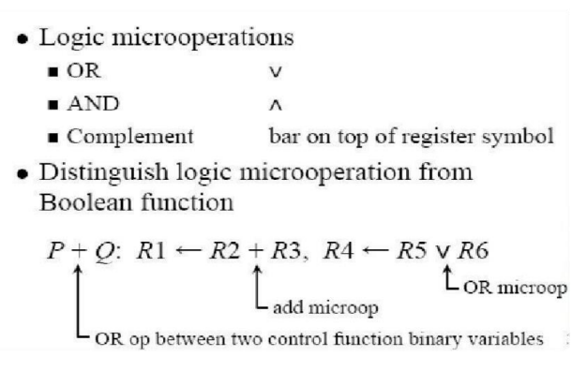
Logic micro-operations

Slide 14
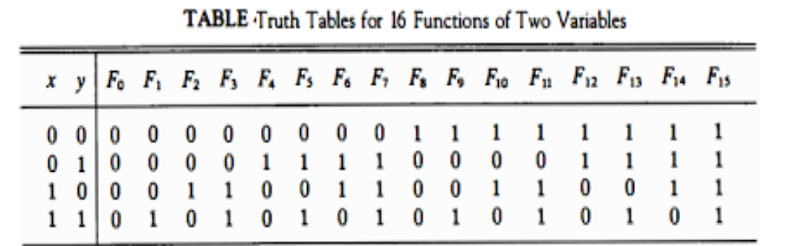
Logic micro-operations

Slide 15
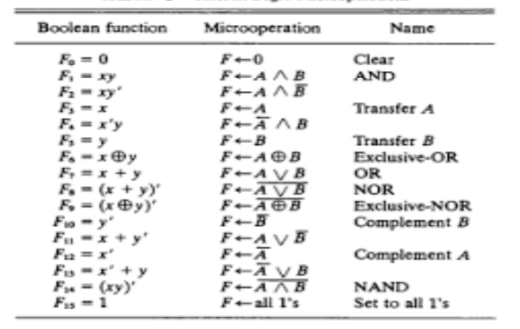
Logic micro-operations

Slide 16
Logic micro-operations
Hardware implementation of logic micro-operations
• The hardware implementation of logic microoperations requires that logic gates be inserted for each bit or pair of bits in the registers to perform the required logic function.
• Although there are 16 logic microoperations, most computers use only four- AND, OR, XOR (exclusive-OR), and complement from which all others can be derived.
• Block diagram shows one stage of a circuit that generates the four basic logic microoperations.
• It consists of four gates and a multiplexer. Each of the four logic operations is generated through a gate that performs the required logic.
• The outputs of the gates are applied to the data inputs of the multiplexer. The two selection inputs S1 and S0 choose one of the data inputs of the multiplexer and direct its value to the output.

Slide 17
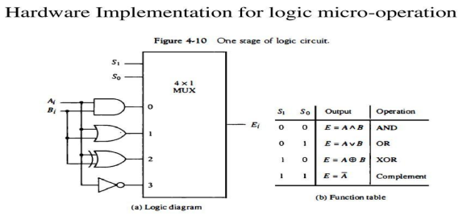

Slide 18
Shift micro-operations
• Shift microoperations are used for serial transfer of data.
• The contents of a register can be shifted to the left or the right.
• During a shift-left operation the serial input transfers a bit into the rightmost position.
• During a shift-right operation the serial input transfers a bit into the leftmost position.
• There are three types of shifts:
logical,
Circular
arithmetic

Slide 19
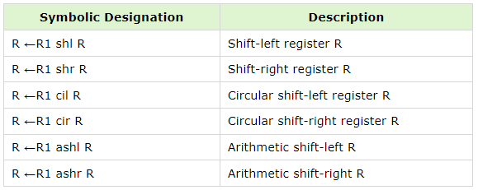

Slide 20
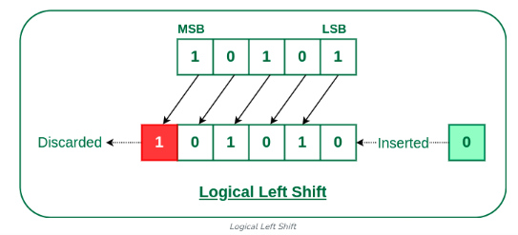
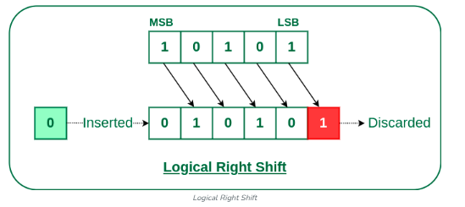

Slide 21
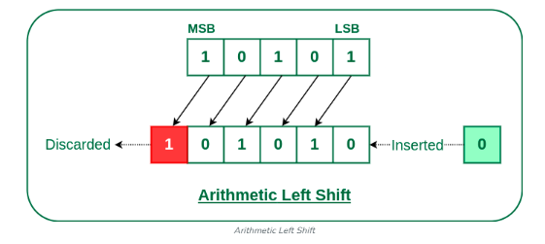
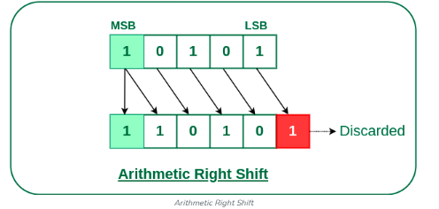

Slide 22
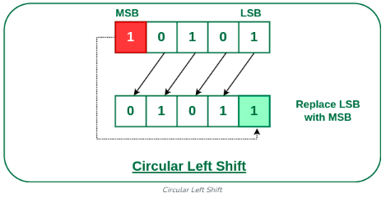
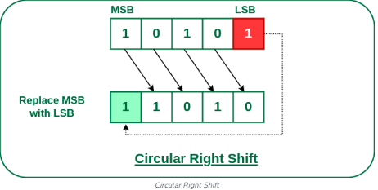

Slide 23
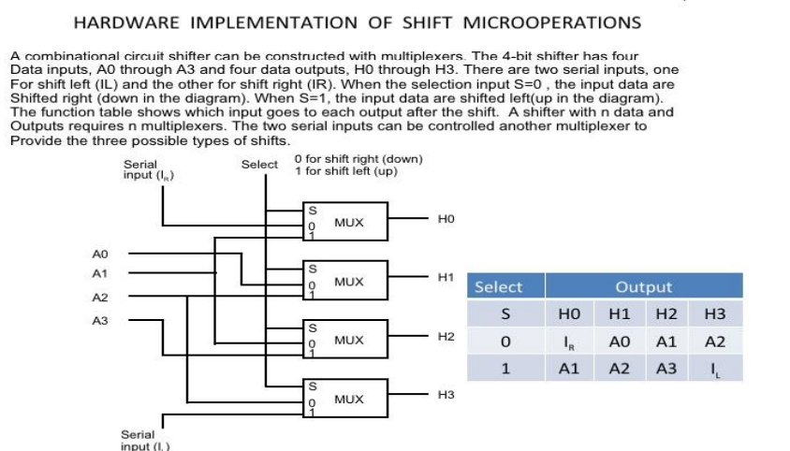

Slide 24
Arithmetic logic shift unit(ALU)
• Instead of having individual registers performing the microoperations directly, computer systems employ a number of storage registers connected to a common operational unit called an arithmetic logic unit, abbreviated ALU.
• The ALU is a combinational circuit so that the entire register transfer operation from the source registers through the ALU and into the destination register can be performed during one clock pulse period.
• The shift microoperations are often performed in a separate unit, but sometimes the shift unit is made part of the overall ALU.
• The arithmetic, logic, and shift circuits introduced in previous sections can be combined into one ALU with common selection variables.
• One stage of an arithmetic logic shift unit is shown in following block diagram.
• Particular microoperation is selected with inputs S1 and S0. A 4 x 1 multiplexer at the output chooses between an arithmetic output in Di and a logic output in Ei.
• The data in the multiplexer are selected with inputs S3 and S2. The other two data inputs to the multiplexer receive inputs Ai-1 for the shift-right operation and Ai+1 for the shift-left operation

Slide 25
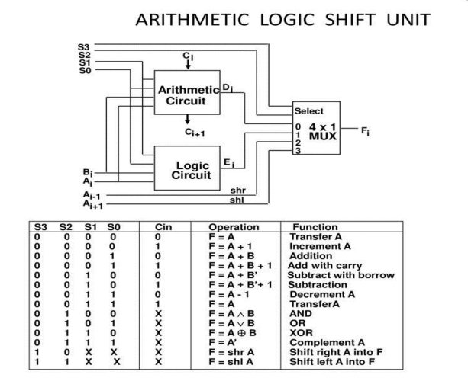

Slide 26
The circuit whose one stage is specified in Fig. 4-13 provides eight arithmetic operation, four logic operations, and two shift operations.
• Each operation is selected with the five variables S3, S2, S1, S0 and Cin.
• The input carry Cin is used for selecting an arithmetic operation only.
• in Table lists the 14 operations of the ALU. The first eight are arithmetic operations and are selected with S3S2 = 00.
• The next four are logic and are selected with S3S2 = 01.
• The input carry has no effect during the logic operations and is marked with don't-care x’s.
• The last two operations are shift operations and are selected with S3S2= 10 and 11.
• The other three selection inputs have no effect on the shift.

Slide 27
Instruction code
An instruction code is a set of bits that lays down a sequence of micro-operation that the computer needs to perform a specific task. Operands are definite elements of instructions which specify the data on which the operation is to be done. The data can be numbers, characters, logical data, and even addresses. For example, an instruction describes an addition operation and the numbers (operand) on which the operation is to be performed.

Slide 28
Instruction code
In general, each instruction code is 16-bit and consists of three parts called fields, which include:
The mode field defines how the location of the operand can be found by the computer.
The operation code field or Opcode specifies the operation, such as addition, subtraction, shift, and complement, to be performed. The bits required for the operation code may vary as it is dependent on the total operations available on the computer.
The address field contains the operand’s address, that is, memory or register memory location. The operand is stored in the computer’s memory just as data is stored. Based on the address of the operand, there are different types of operands: direct operand, indirect operand, and immediate operand.
Mode | Opcode | Address of the Operand

Slide 29

Types of instruction code
Memory-reference instruction: In this type of code, 12 bits are used to specify the memory address, 3 bits for the opcode (000 to 110), and 1 bit to specify the mode as indirect addressing mode (I).
AND | And memory word to AC
ADD | Add memory word to AC
LDA | Load memory word to AC
STA | Store AC content in memory

Slide 30

Register-reference instruction: In this type of code, 12 bits indicate the register operation address, 3 bits for the opcode (111), and 1 bit is utilized for setting the mode as 0. The instructions are executed on the register.
CLE | Clear E(overflow bit)
CMA | Complement AC
CME | Complement E
INC | Increment AC
HLT | Halt computer

Slide 31

Input-output instruction: This type of code contains a 12-bit input/output operation address, 3 bits for the opcode (111), and 1 bit is utilized for setting the mode as 1. These instructions are required to transfer to and from the AC register and output device.
INP | Input character to AC
OUT | Output character from AC

Slide 32
Instruction Cycle
A computer program consists of orderly instructions that are executed by a processor through a cycle called the instruction cycle. Each instruction cycle is executed in the following phases:
Fetching instructions from the memory unit
Decoding the instruction
Reading the operand address from memory
Executing the instruction
After executing an instruction, the cycle starts again at step 1, for the next instruction. The program instructions are stored in RAM. The processor initiates the execution program by fetching the instructions one at a time from the RAM. The CPU’s control unit decodes the operand part of the instruction, based on the instruction format. The ALU component of the CPU is responsible for the execution of the instructions and operation of data.

Slide 33
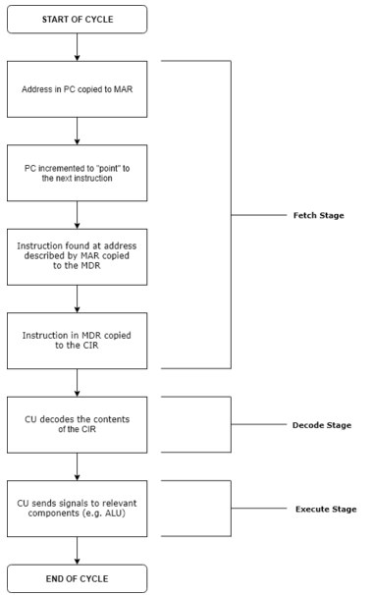
Instruction Cycle

Slide 34
Instruction Cycle
Fetch stage: The next instruction is fetched from the memory address that is currently stored in the program counter and stored into the instruction register. At the end of the fetch operation, the PC points to the next instruction that will be read at the next cycle.
Decode stage: During this stage, the encoded instruction presented in the instruction register is interpreted by the decoder.
Read the effective address: In the case of a memory instruction (direct or indirect), the execution phase will be during the next clock pulse. If the instruction has an indirect address, the effective address is read from main memory, and any required data is fetched from main memory to be processed and then placed into data registers (clock pulse: T₃). If the instruction is direct, nothing is done during this clock pulse. If this is an I/O instruction or a register instruction, the operation is performed during the clock pulse.
Execute stage: The control unit of the CPU passes the decoded information as a sequence of control signals to the relevant functional units of the CPU to perform the actions required by the instruction, such as reading values from registers, passing them to the ALU to perform mathematical or logic functions on them, and writing the result back to a register. If the ALU is involved, it sends a condition signal back to the CU. The result generated by the operation is stored in the main memory or sent to an output device. Based on the feedback from the ALU, the PC may be updated to a different address from which the next instruction will be fetched.

Slide 35
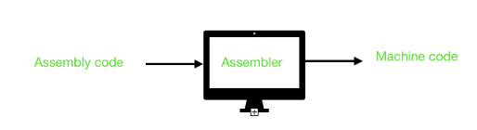
Assembler
Assembler is a program for converting instructions written in low-level assembly code into relocatable machine code and generating along information for the loader.
It is necessary to convert user written programs into a machinery code. This is called as translation of the high level language to low level that is machinery language. This type of translation is performed with the help of system software. Assembler can be defined as a program that translates an assembly language program into a machine language program. Self assembler is a program that runs on a computer and produces the machine codes for the same computer or same machine. It is also known as resident assembler. A cross assembler is an assembler which runs on a computer and produces the machine codes for other computer.

Slide 36

Machine language
Machine language is a low-level language made up of binary numbers or bits that a computer can understand. It is also known as machine code or object code and is extremely tough to comprehend. The only language that the computer understands is machine language. All programmes and programming languages, such as Swift and C++, produce or run programmes in machine language before they are run on a computer. When a specific task, even the smallest process executes, machine language is transported to the system processor. Computers are only able to understand d binary data as they are digital devices.
Examples of Machine language
The text "Hello World" would be written in the machine language:
Another example of machine language is given below, which will display the letter "A" 1000 times on the screen.
169 1 160 0 153 0 128 153 0 129 153 130 153 0 131 200 208 241 96

Slide 37
Uses of Machine Language
Common uses of machine language are discussed below:
Machine language is a low-level language that machines understand but that humans can decipher using an assembler.
A compiler plays an important role between humans and computers as it converts machine language into other code or language that is understandable by humans.
Assembly language is dedicated to comprehending machine language since it is a rip-off of it.

Slide 38
Machine Language | Assembly Language
Machine language is a low-level programming language made out of binary numbers or bits that can only be read by machines. It is also known as machine code or object code, in which instructions are executed directly by the CPU. | Assembly language is a human-only language that is not understood by computers. As a result, it acts as a link between high-level programming languages and machine languages, requiring the usage of an assembler to convert instructions into machine or object code.
Machine language includes binary digits (0s and 1s), hexadecimal and octal decimal, which can be comprehended only by computers and cannot be deciphered by humans. | Mnemonics such as Mov, Add, Sub, End, and others make up the assembly language, which people can understand, utilise, and apply.
In machine language, error fixing and modifications cannot be done, and the features of machine languages are varied accordingly. | Assembly language has conventional instruction sets, as well as the ability to correct errors and modify programs.
Machine languages are platform-dependent and very difficult to understand by human beings. | The syntaxes of Assembly languages are similar to the English language; therefore, it is easy to understand by a human.
Machine language is not possible to learn as it is difficult to memorize and serves as a machine code only. | Assembly language is easy to memorize, and it is used for microprocessor-based applications/ devices and real-time systems.
In machine language, all data is present in binary format that makes it fast in execution. | As compared to machine language, the execution speed of assembly language is slow.
The sequences of bits are used by Machine language to give commands. Zero represents the off or false state, while one represents the on or true state. It is dependent on the CPU to the conversion of high-level programming language to machine language. | Instead of using raw sequences of bits, assembly language uses "mnemonics" names and symbols; therefore, users do not need to remember op-codes with assembly language. In assembly languages, humans can map the code to machine code, and the codes are slightly more readable
The first-generation programming languages are Machine languages, which do not need a translator. | The second generation of programming languages is assembly languages, which use assembler as a translator to convert mnemonics into machine-understandable form.
Machine language is hardware-dependent and does not allow for modification. | Assembly language is not portable, and it is machine-dependent and can be modified easily.
In the syntax of machine language, there are more chances of errors. | As compared to machine language, there are fewer chances of syntax errors in assembly language.

Slide 39
Memory hierarchy
The memory unit is an essential component in any digital computer since it is needed for storing programs and data
Not all accumulated information is needed by the CPU at the same time
Therefore, it is more economical to use low-cost storage devices to serve as a backup for storing the information that is not currently used by CPU
Computer Memory Hierarchy is a pyramid structure that is commonly used to illustrate the significant differences among memory types.
The memory unit that directly communicate with CPU is called the main memory
Devices that provide backup storage are called auxiliary memory
The memory hierarchy system consists of all storage devices employed in a computer system from the slow by high-capacity auxiliary memory to a relatively faster main memory, to an even smaller and faster cache memory

Slide 40
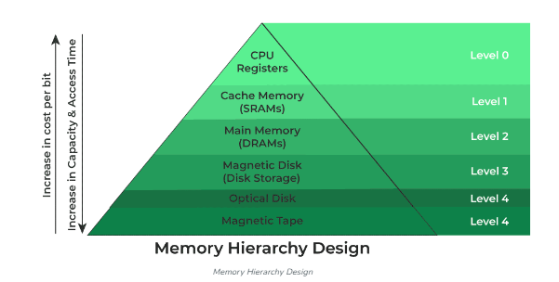
Diagram

Slide 41
Main memory
Most of the main memory in a general purpose computer is made up of RAM integrated circuits chips, but a portion of the memory may be constructed with ROM chips
RAM– Random Access memory – Integrated RAM are available in two possible operating modes, Static and Dynamic
ROM– Read Only memory

Slide 42
RAM
RAM chip is better suited for communication with the CPU if it has one or more control inputs that select the chip when needed Read/write memory, that initially doesn’t contain any data
The computing system that it is used in usually stores data at various locations to retrieve it latter from these locations
Its data pins are bidirectional (data can flow into or out of the chip via these pins), as opposite to those of ROM that are output only
It loses its data once the power is removed, so it is a volatile memory
It has a directional select signal R/W’; When R/W’=1, the chip outputs data to the rest of the circuit; when R/W’ = 0 it inputs data from the rest of the circuit

Slide 43
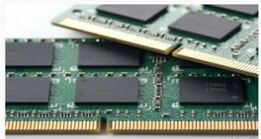
RAM IMAGE

Slide 44
RAM
Static RAM (SRAM)
Each cell stores bit with a six-transistor (Diode) circuit.
Retains value indefinitely, as long as it is kept powered.
Relatively insensitive to disturbances such as electrical noise.
Faster and more expensive than
DRAM. Dynamic RAM (DRAM)
Each cell stores bit with a capacitor and transistor. ▪Value must be refreshed every 10-100 ms.
Sensitive to disturbances.
Slower and cheaper than SRAM.

Slide 45
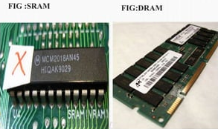
SRAM & DRAM

Slide 46
ROM
ROM is used for storing programs that are PERMENTLY resident in the computer and for tables of constants that do not change in value once the production of the computer is completed.
The ROM portion of main memory is needed for storing an initial program called bootstrap loader, witch is to start the computer software operating when power is turned off
Masked ROM – programmed with its data when the chip is fabricated
PROM – programmable ROM, by the user using a standard PROM programmer, by burning some special type of fuses. Once programmed will not be possible to program it again
EPROM – erasable ROM; the chip can be erased and chip reprogrammed; programming process consists in charging some internal capacitors; the UV light (method of erase) makes those capacitors to leak their charge, thus resetting the chip
EEPROM – Electrically Erasable PROM; it is possible to modify individual locations of the memory, leaving others unchanged; one common use of the EEPROM is in BIOS of personal computers.

Slide 47
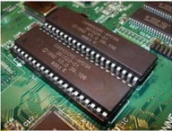
ROM

Slide 48
Auxiliary Memory
The main memory construction is costly. Therefore, it has to be limited in size. The main memory is used to store only those instructions and data which are to be used immediately. However, a computer has to store a large amount of information. The bulk of information is stored in the auxiliary memory. This is also called backing storage or secondary storage. They include hard disk, floppy disks, CD-ROM, USB flash drives, etc.
When the electricity supply to the computer is off, all data stored in the primary storage is destroyed. On the other hand, this is not true for secondary storage. The data stored in secondary storage can be stored for the desired time

Slide 49

Auxiliary Memory

Slide 50
Cache memory
If the active portions of the program and data are placed in a fast small memory, the average memory access time can be reduced,
Thus reducing the total execution time of the program
Such a fast small memory is referred to as cache memory
The cache is the fastest component in the memory hierarchy and approaches the speed of CPU component
When CPU needs to access memory, the cache is examined
If the word is found in the cache, it is read from the fast memory
If the word addressed by the CPU is not found in the cache, the main memory is accessed to read the word
The basic characteristic of cache memory is its fast access time,
Therefore, very little or no time must be wasted when searching the words in the cache Cache memory

Slide 51
Virtual memory
Virtual memory is a common part of operating system on desktop computers.
The term virtual memory refers to something which appears to be present but actually it is not.
The virtual memory technique allows users to use more memory for a program than the real memory of a computer.
Virtual memory is a imaginary memory which we are assuming. If we have a material that exceed your memory at that time we need to use the concept of virtual memory.
virtual memory is temporary memory which is used along with the ram of the system.

Slide 52
ASSOCIATIVE MEMORY
To search particular data in memory, data is read from certain address and compared if the match is not found content of the next address is accessed and compared.
This goes on until required data is found. The number of access depend on the location of data and efficiency of searching algorithm.
This searching time can be reduced if data is searched on the basis of content.
A memory unit accessed by content is called associative memory or content addressable memory(CAM) or associative storage or associative array.
This type of memory is accessed simultaneously and in parallel on the basis of data content.
Memory is capable of finding empty unused location to store the word.

Slide 53
TYPE OF ASSOCIATIVE MEMORY
Auto-associative
Auto-associative memory takes back(retrieves) a previously stored pattern that most closely resembles the current pattern. Hetero-associative
Hetero-associative memory
the retrieved pattern is in general, different from the input pattern not only in content but possibly also in type and format.
Neutral networks are used to implement these associative memory models called NAM (Neutral associative memory).

